Slide 1
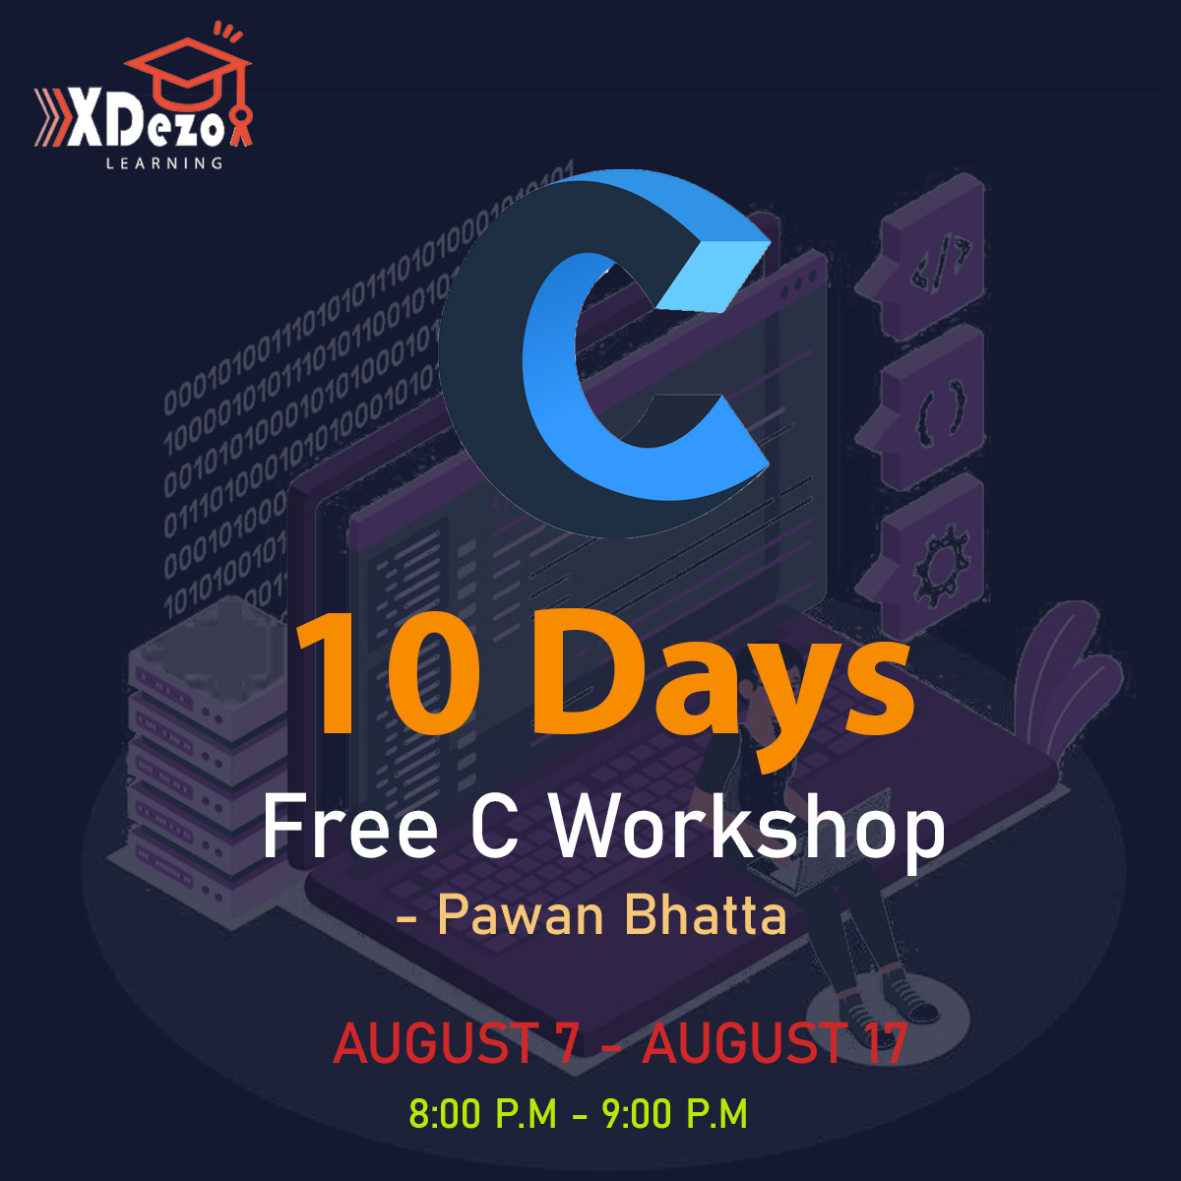

Slide 2
10 Days C Programming Workshop

Slide 3
Course content
Day 1 : Variables, Data types, Constants, Comments and Operators
Day 2 : Control Statements
Day 3 : Array and strings
Day 4 : Functions
Day 5 : Structure and Union
Day 6 : Pointers
Day 7 : File Handling
Day 8 : Algorithm and Flowchart
Day 9 : Introduction to graphics and a real life project
Day 10 : Past Questions Solving

Slide 4
Variables
Variable is a container that stores particular type of data in C. A variable may contain integer , floating number or character. Rules for declaring variables in C: 1. Variable name can only contain alphabets or numbers or underscore. 2. Variable name can’t start with numbers. 3. Variable names in C are case sensitive. 4. Variable name can’t be keywords that are pre-defined in C language.

Slide 5
Data Types
In C programming, data types are declarations for variables. This determines the type and size of data associated with variables. For example, int myAge; char firstLetter; float salary;

Slide 6
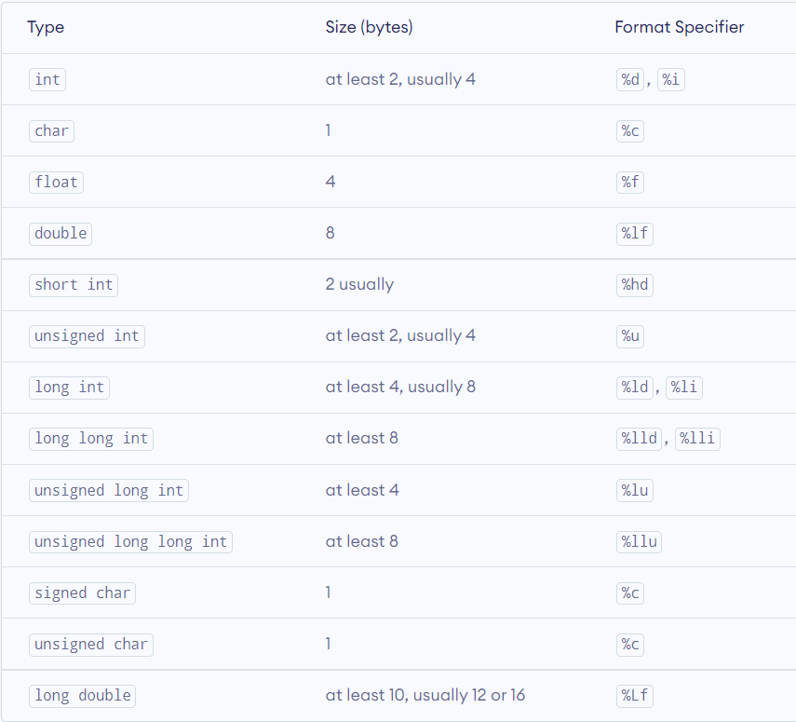
Data Types

Slide 7
Constants
A constant is basically a named memory location in a program that holds a single value throughout the execution of that program. Character constants, real constants and integer constants , etc. are the types of constants.
We can create constants in the C programming language by using two of the concepts mentioned below:
1. By using the ‘#define’ preprocessor
2. By using the ‘const’ keyword

Slide 8
Constants
Declaring constants using const keyword: Syntax: const datatype constantName = value ;
Declaring constants using #define processor: Syntax: #define CONSTANTNAME value

Slide 9
Comments in C
Comments in C are the statements that is not executed by C compiler.
Comments are hints that a programmer can add to make their code easier to read and understand.
There are two types of comments in C: 1. Single line comment ( //…….. ) 2. Multi line comment ( /*……*/ )

Slide 10
Operators
An operator is a symbol that operates on a value or a variable. For example: + is an operator to perform addition.
There are following types of operators in C: 1. Arithmetic Operators 2. Increment and Decrement Operators 3. Assignment Operators 4. Relational Operators 5. Logical Operators 6. Bitwise Operators

Slide 11
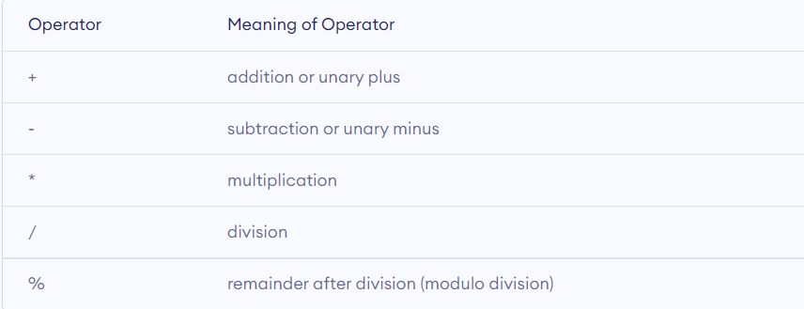
Arithmetic Operators
An arithmetic operator performs mathematical operations such as addition, subtraction, multiplication, division etc on numerical values (constants and variables).

Slide 12
Increment and Decrement Operators
C programming has two operators increment (++) and decrement (--) to change the value of operand.
Increment (++) increases the value by 1 and Decrement (--) decreases the value by 1.
These operators are unary operators i.e. they only operate on a single operand.

Slide 13
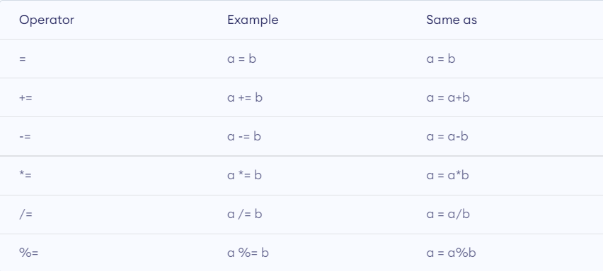
Assignment Operators
The assignment operator is used to assign a value to a variable.
The most common assignment operator is (=).

Slide 14
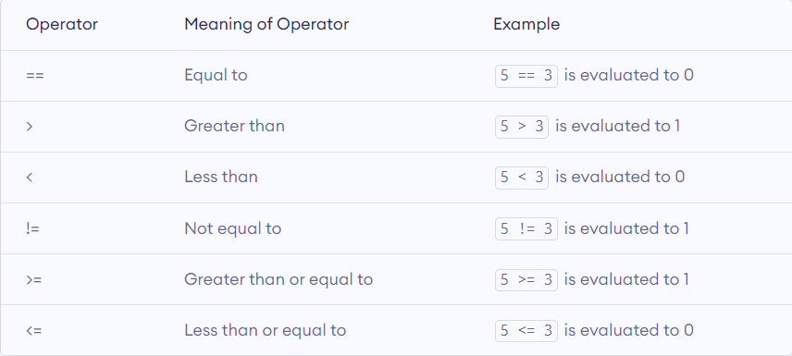
Relational operators
Relational operator checks the relation between two operators. If the relation is true, it returns 1 and if the relation is false, it returns 0.

Slide 15
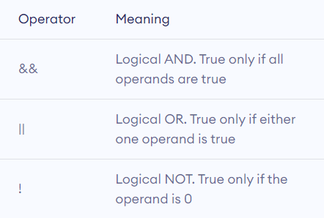
Logical Operators
An expression containing logical operator returns either 0 or 1 depending upon whether expression results true or false.

Slide 16
Bitwise operators
The bitwise operators are the operators used to perform the operations on the data at the bit-level. When we perform the bitwise operations, then it is also known as bit-level programming. It consists of two digits, either 0 or 1. It is mainly used in numerical computations to make the calculations faster.

Slide 17
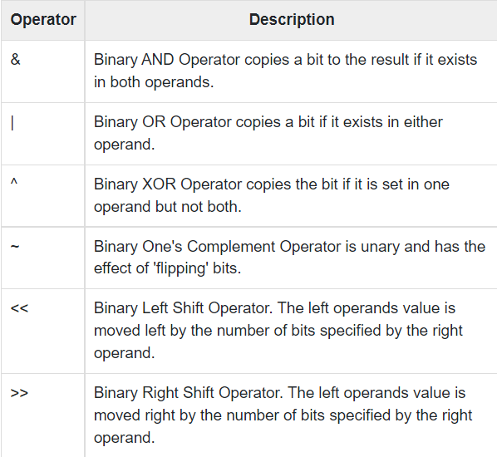
Bitwise operators

Slide 18
Ternary Operators
The operators, which require three operands to act upon, are known as ternary operators. It can be represented by “ ? : ”. It is also known as conditional operator. The operator improves the performance and reduces the line of code.
Expression1 ? Expression2 : Expression3
For example : x<y ? printf(“Hello”) : printf(“Bye”);

Slide 19
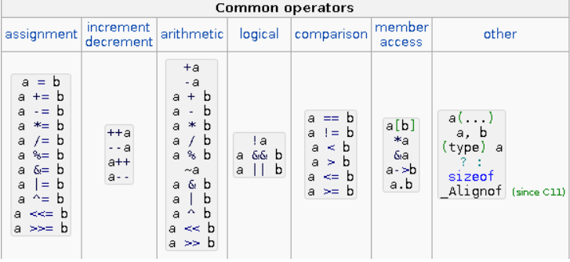
Operator Precedence

